Slide 1

Group 3 Topic: Smokers in Public Places

Slide 2
About the Topic
The new law in our country had implemented the nation wide smoking
Smokers in our country having trouble finding a smoking area
By this needfinding activity it can help those people find the place to smoke

Slide 3
Project: Mobile Application Application Name: Smocket
This app can find places where there are smoking areas.
It will be useful to them by just downloading this app.
Not only smoker but any person can use this app, it can serve as a warning to them that this place is a smoking zone and they can avoid it.

Slide 4
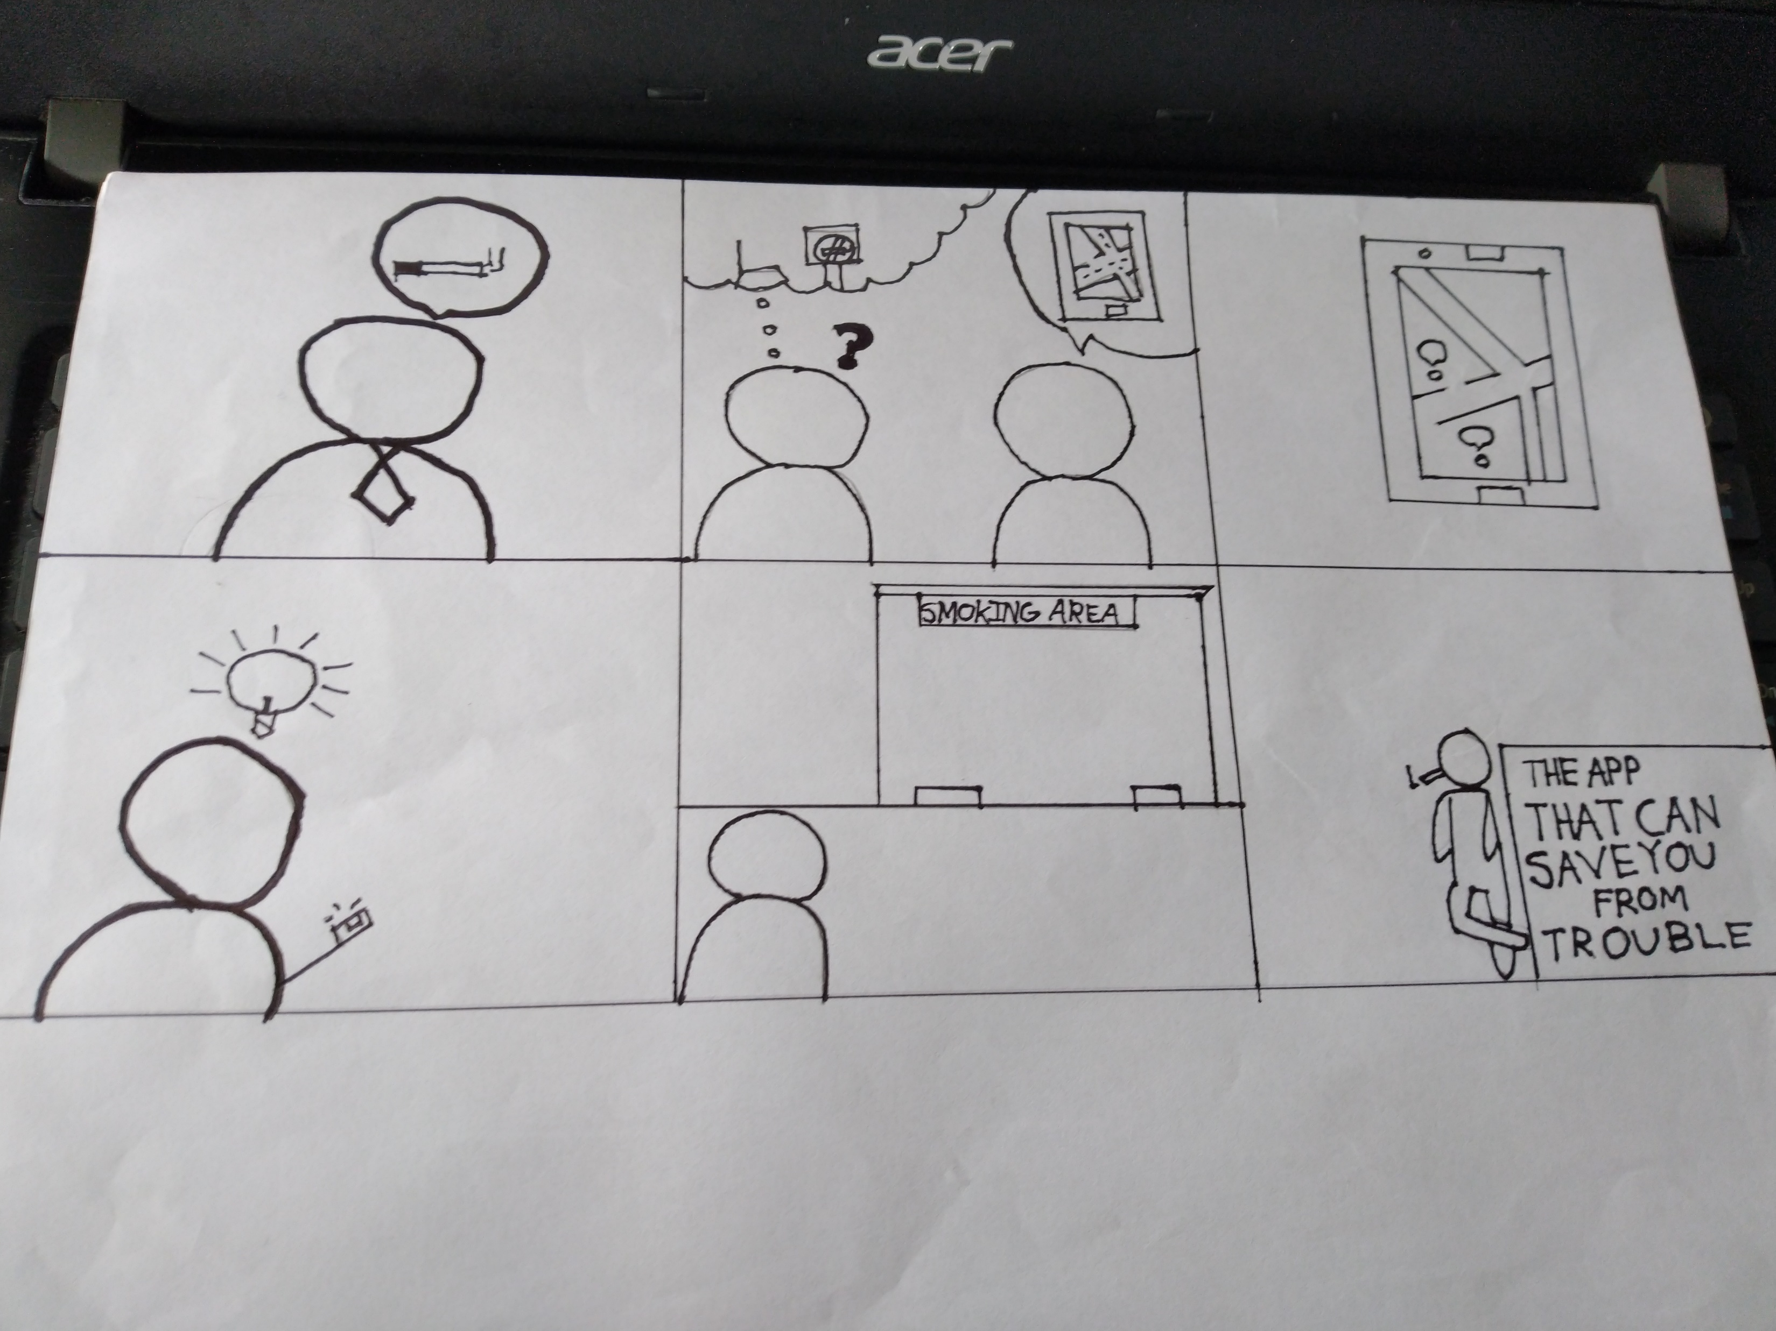
Storyboard 1: Smoker point of view

Slide 5
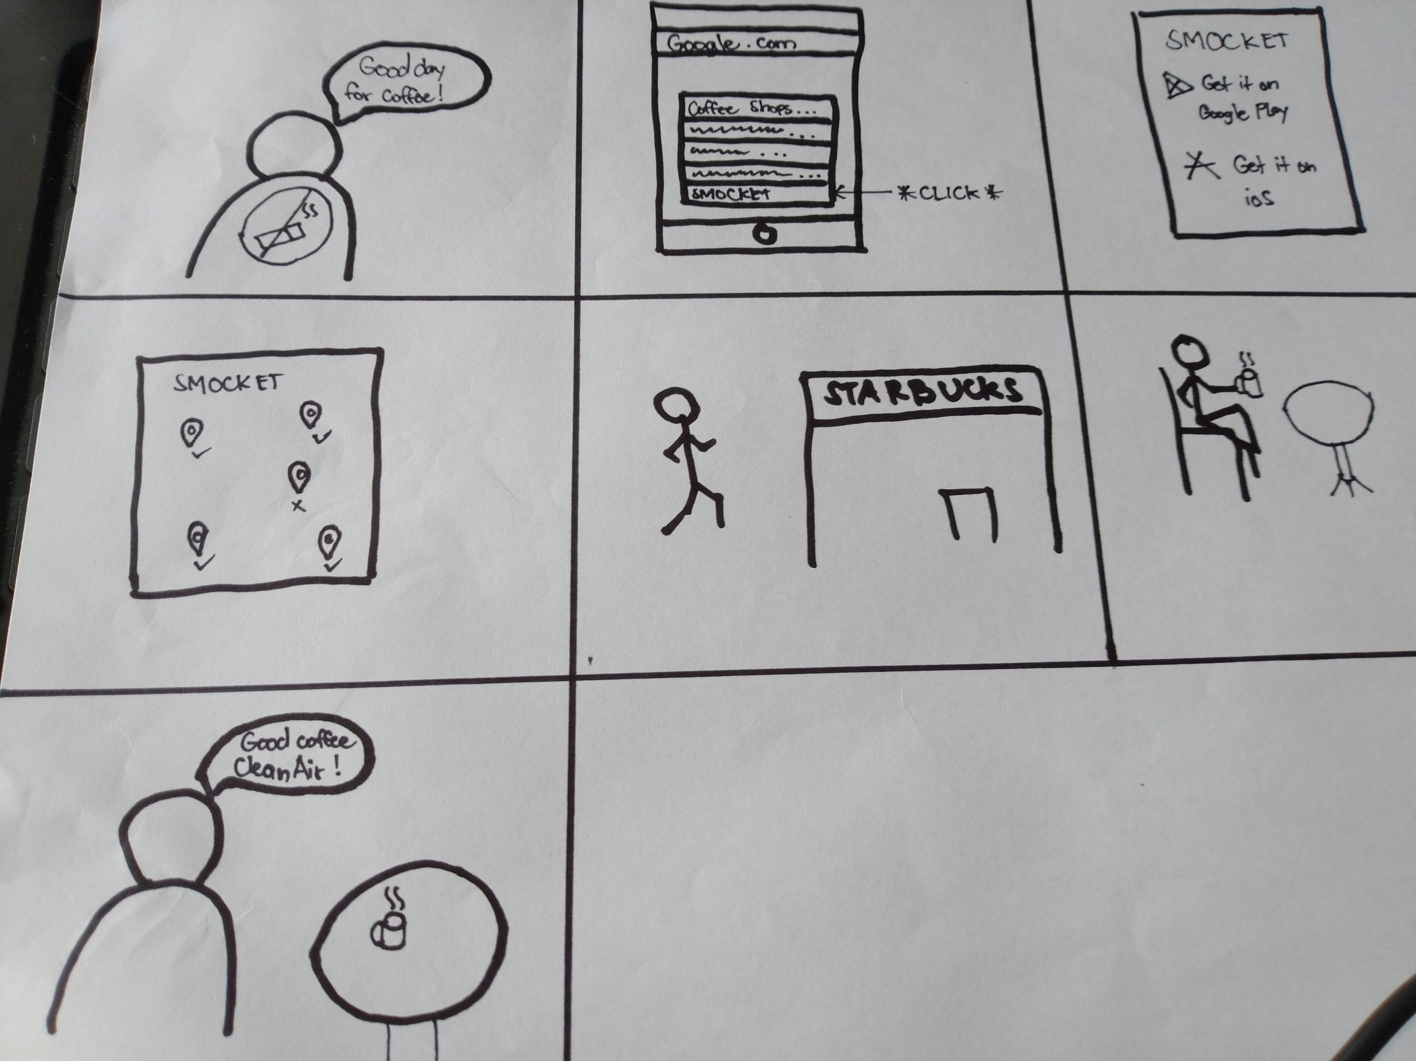
Storyboard 2:

Slide 6
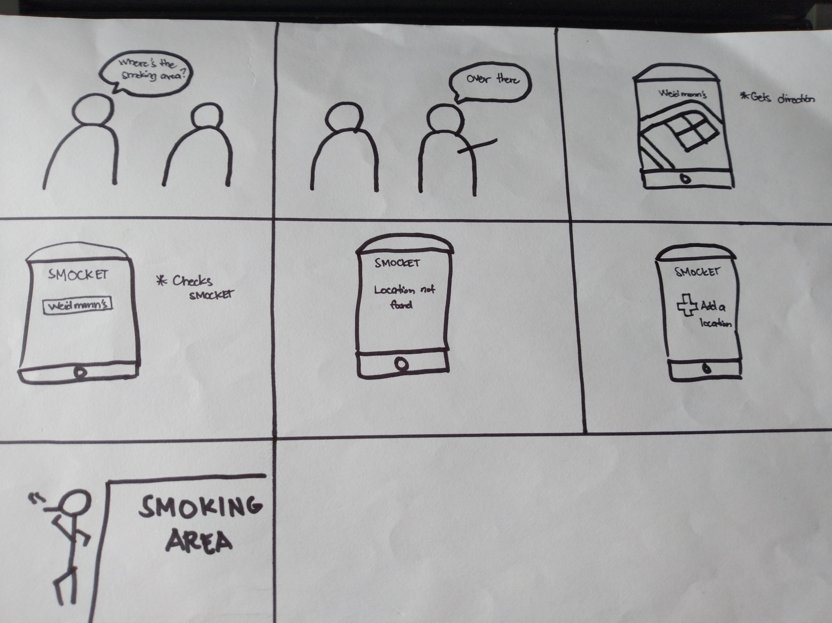
Storyboard 3:

Slide 7
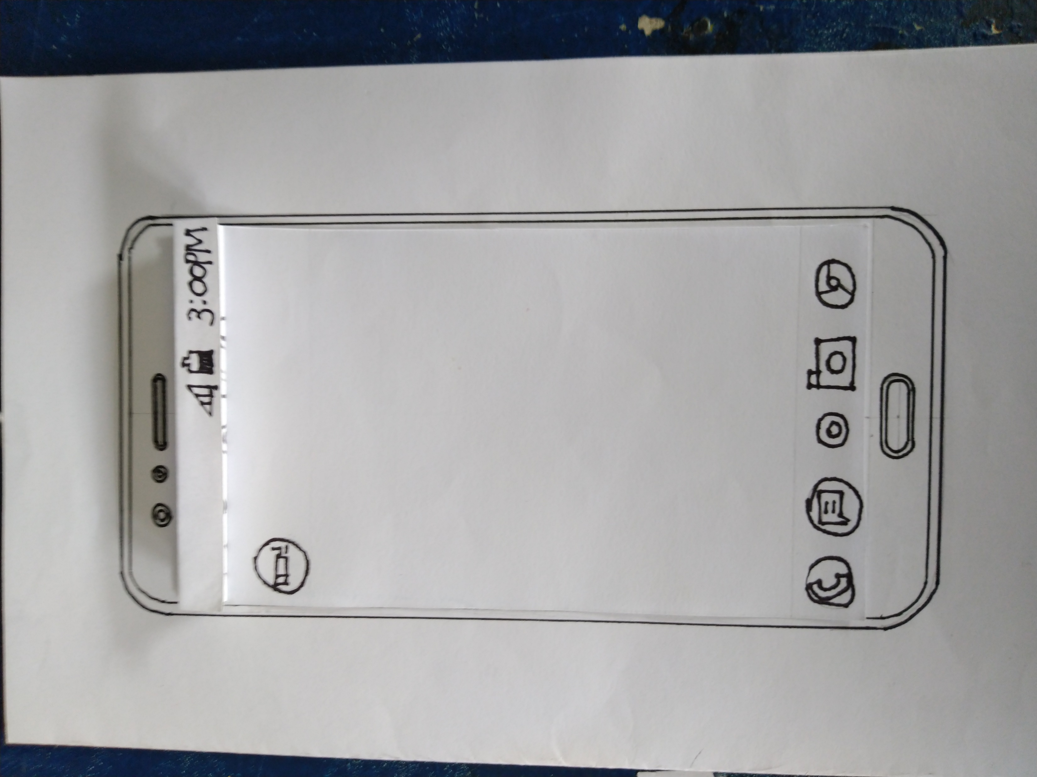
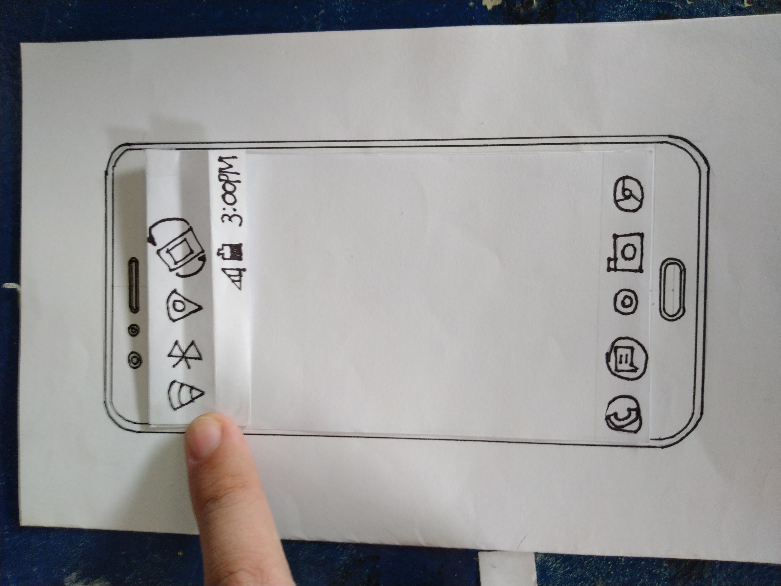
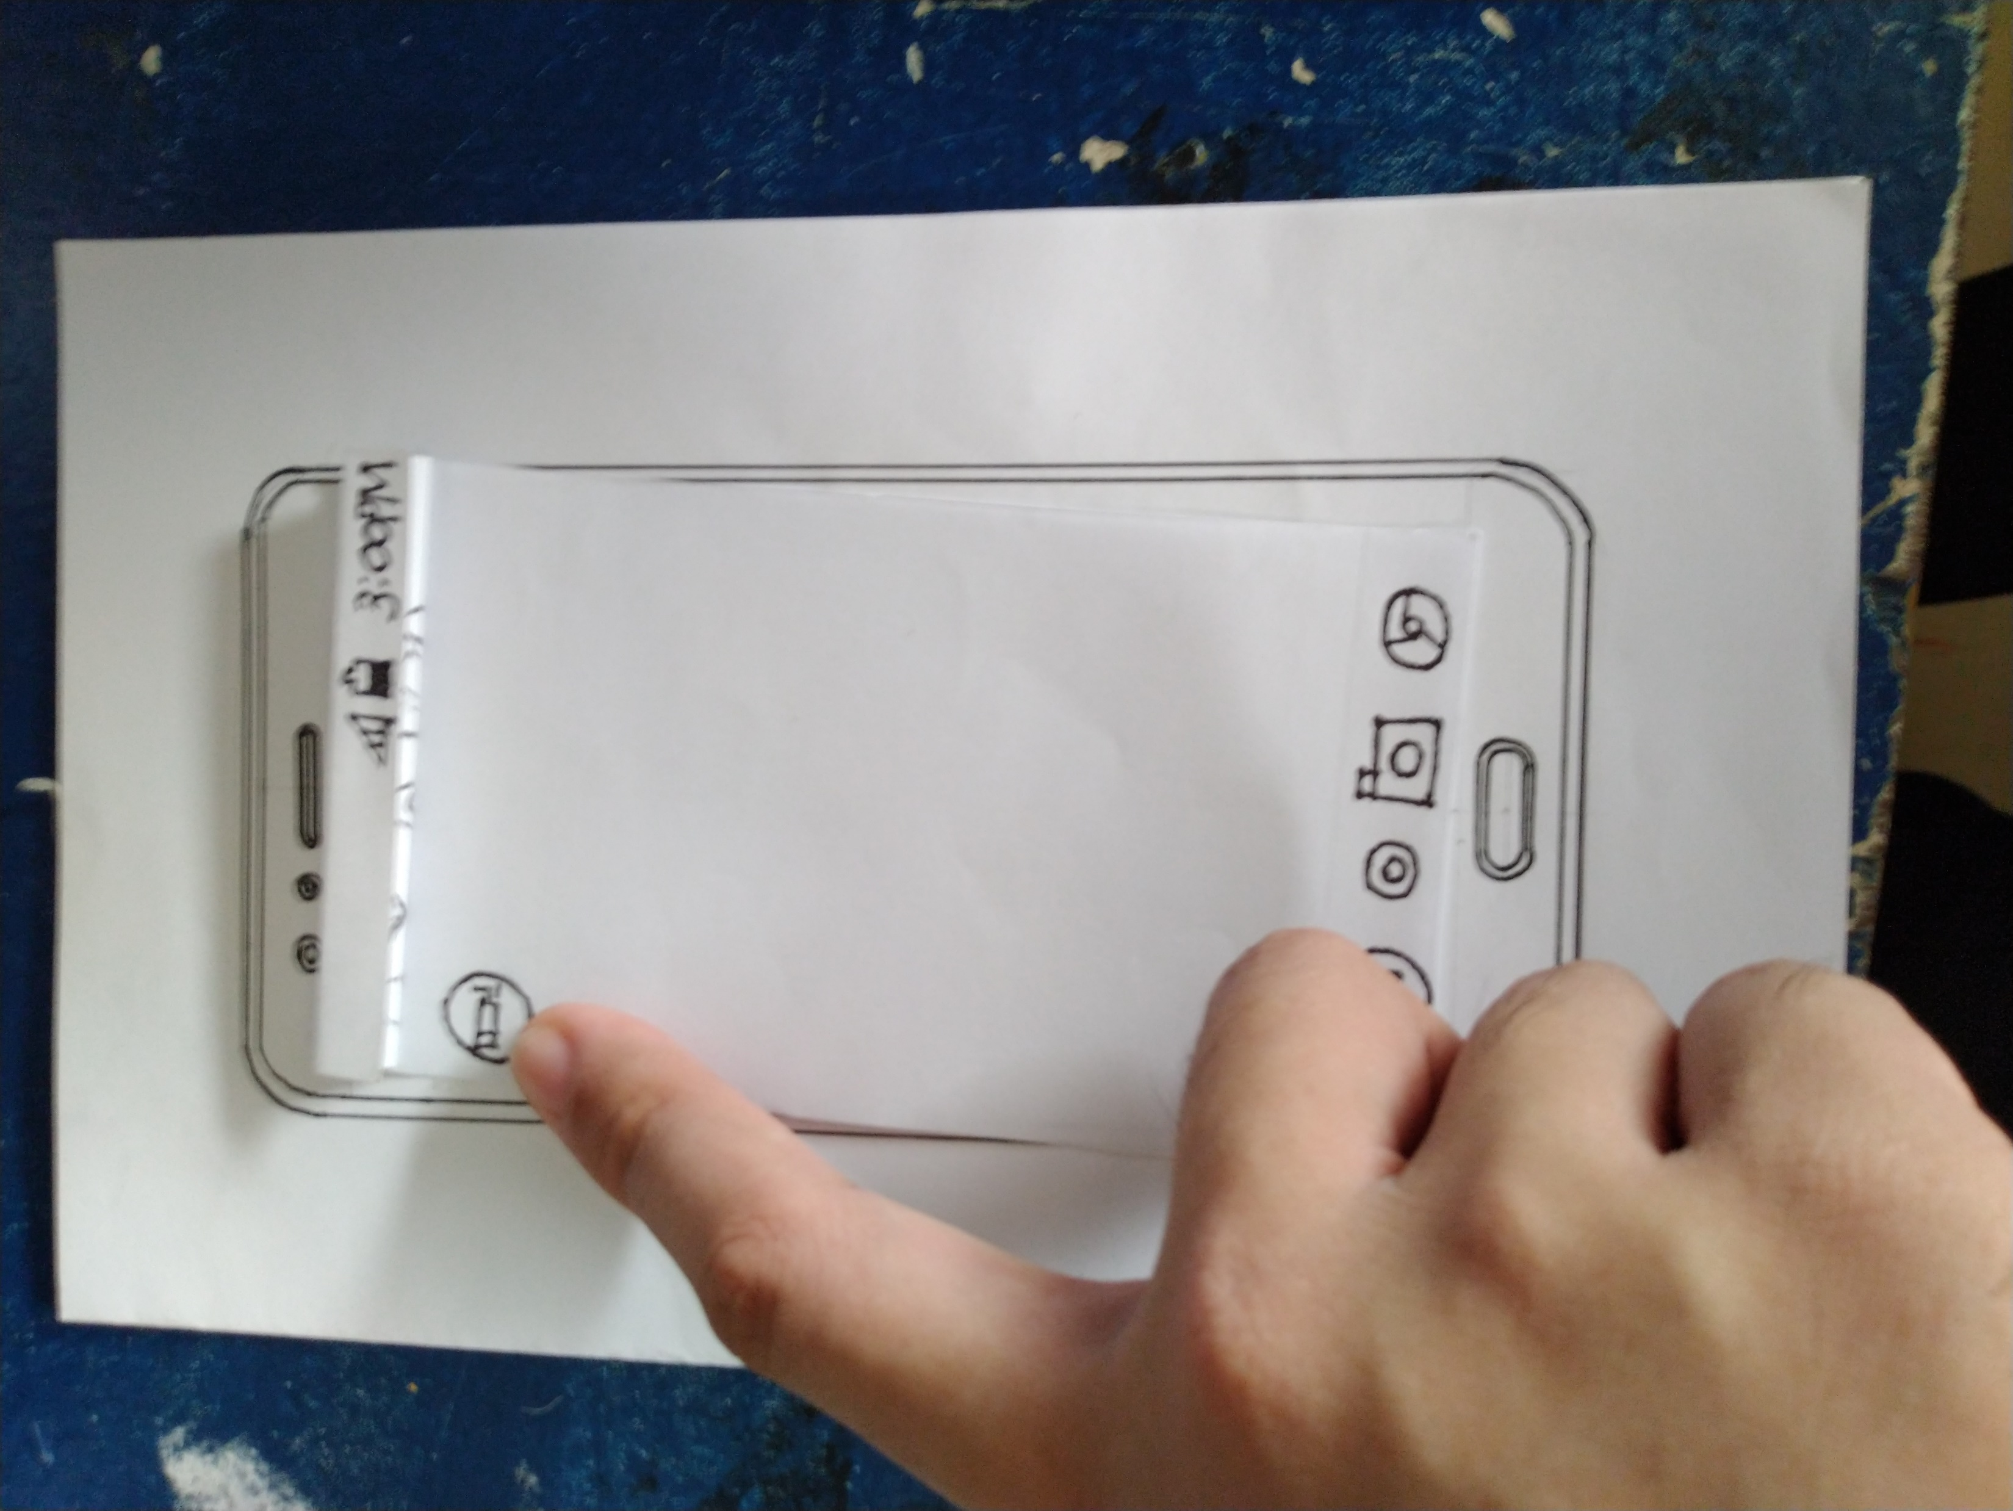
Paper prototype 1
Source https://www.payscale.com

Slide 8
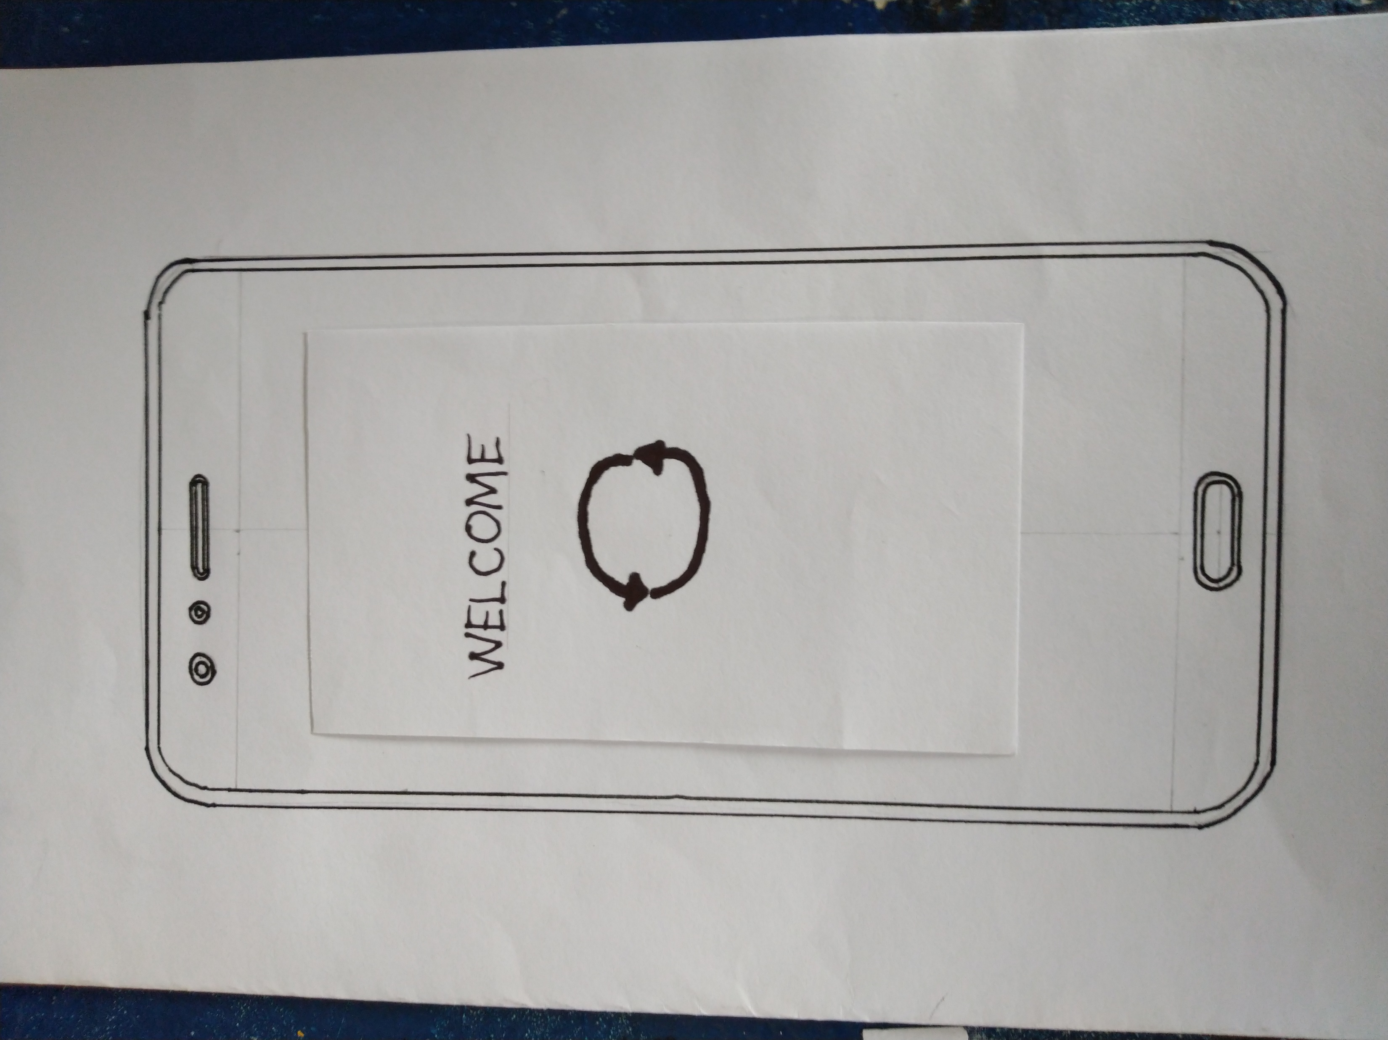
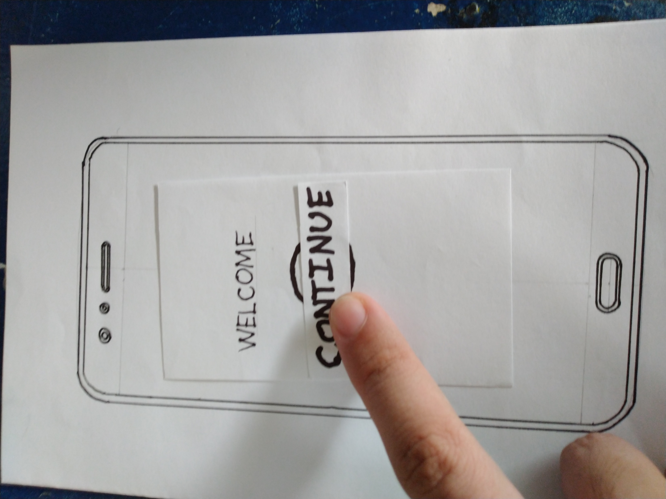
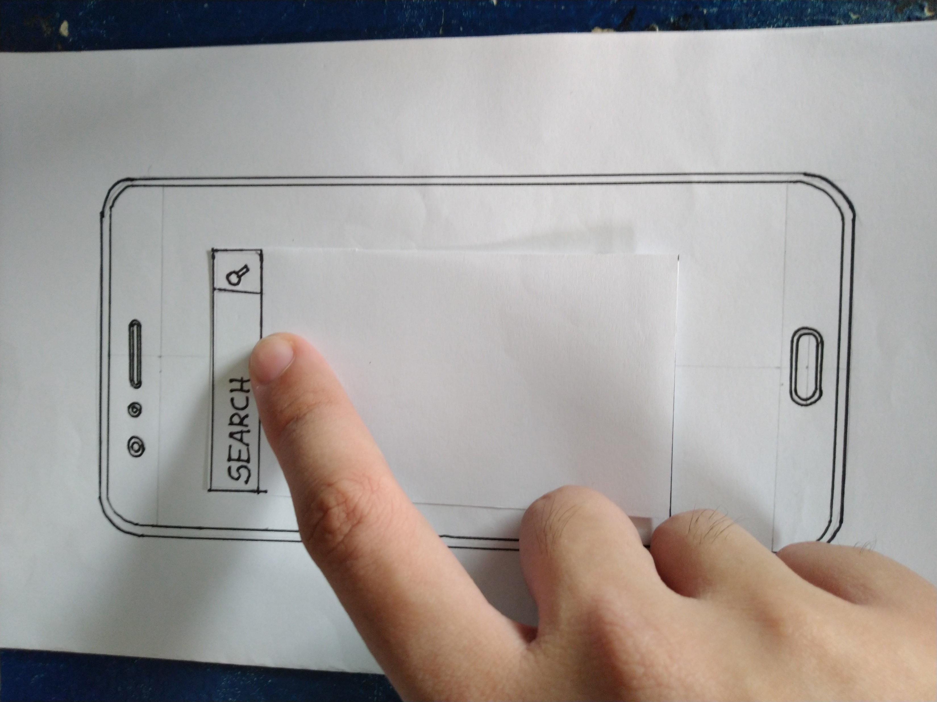
Paper Prototype 1

Slide 9
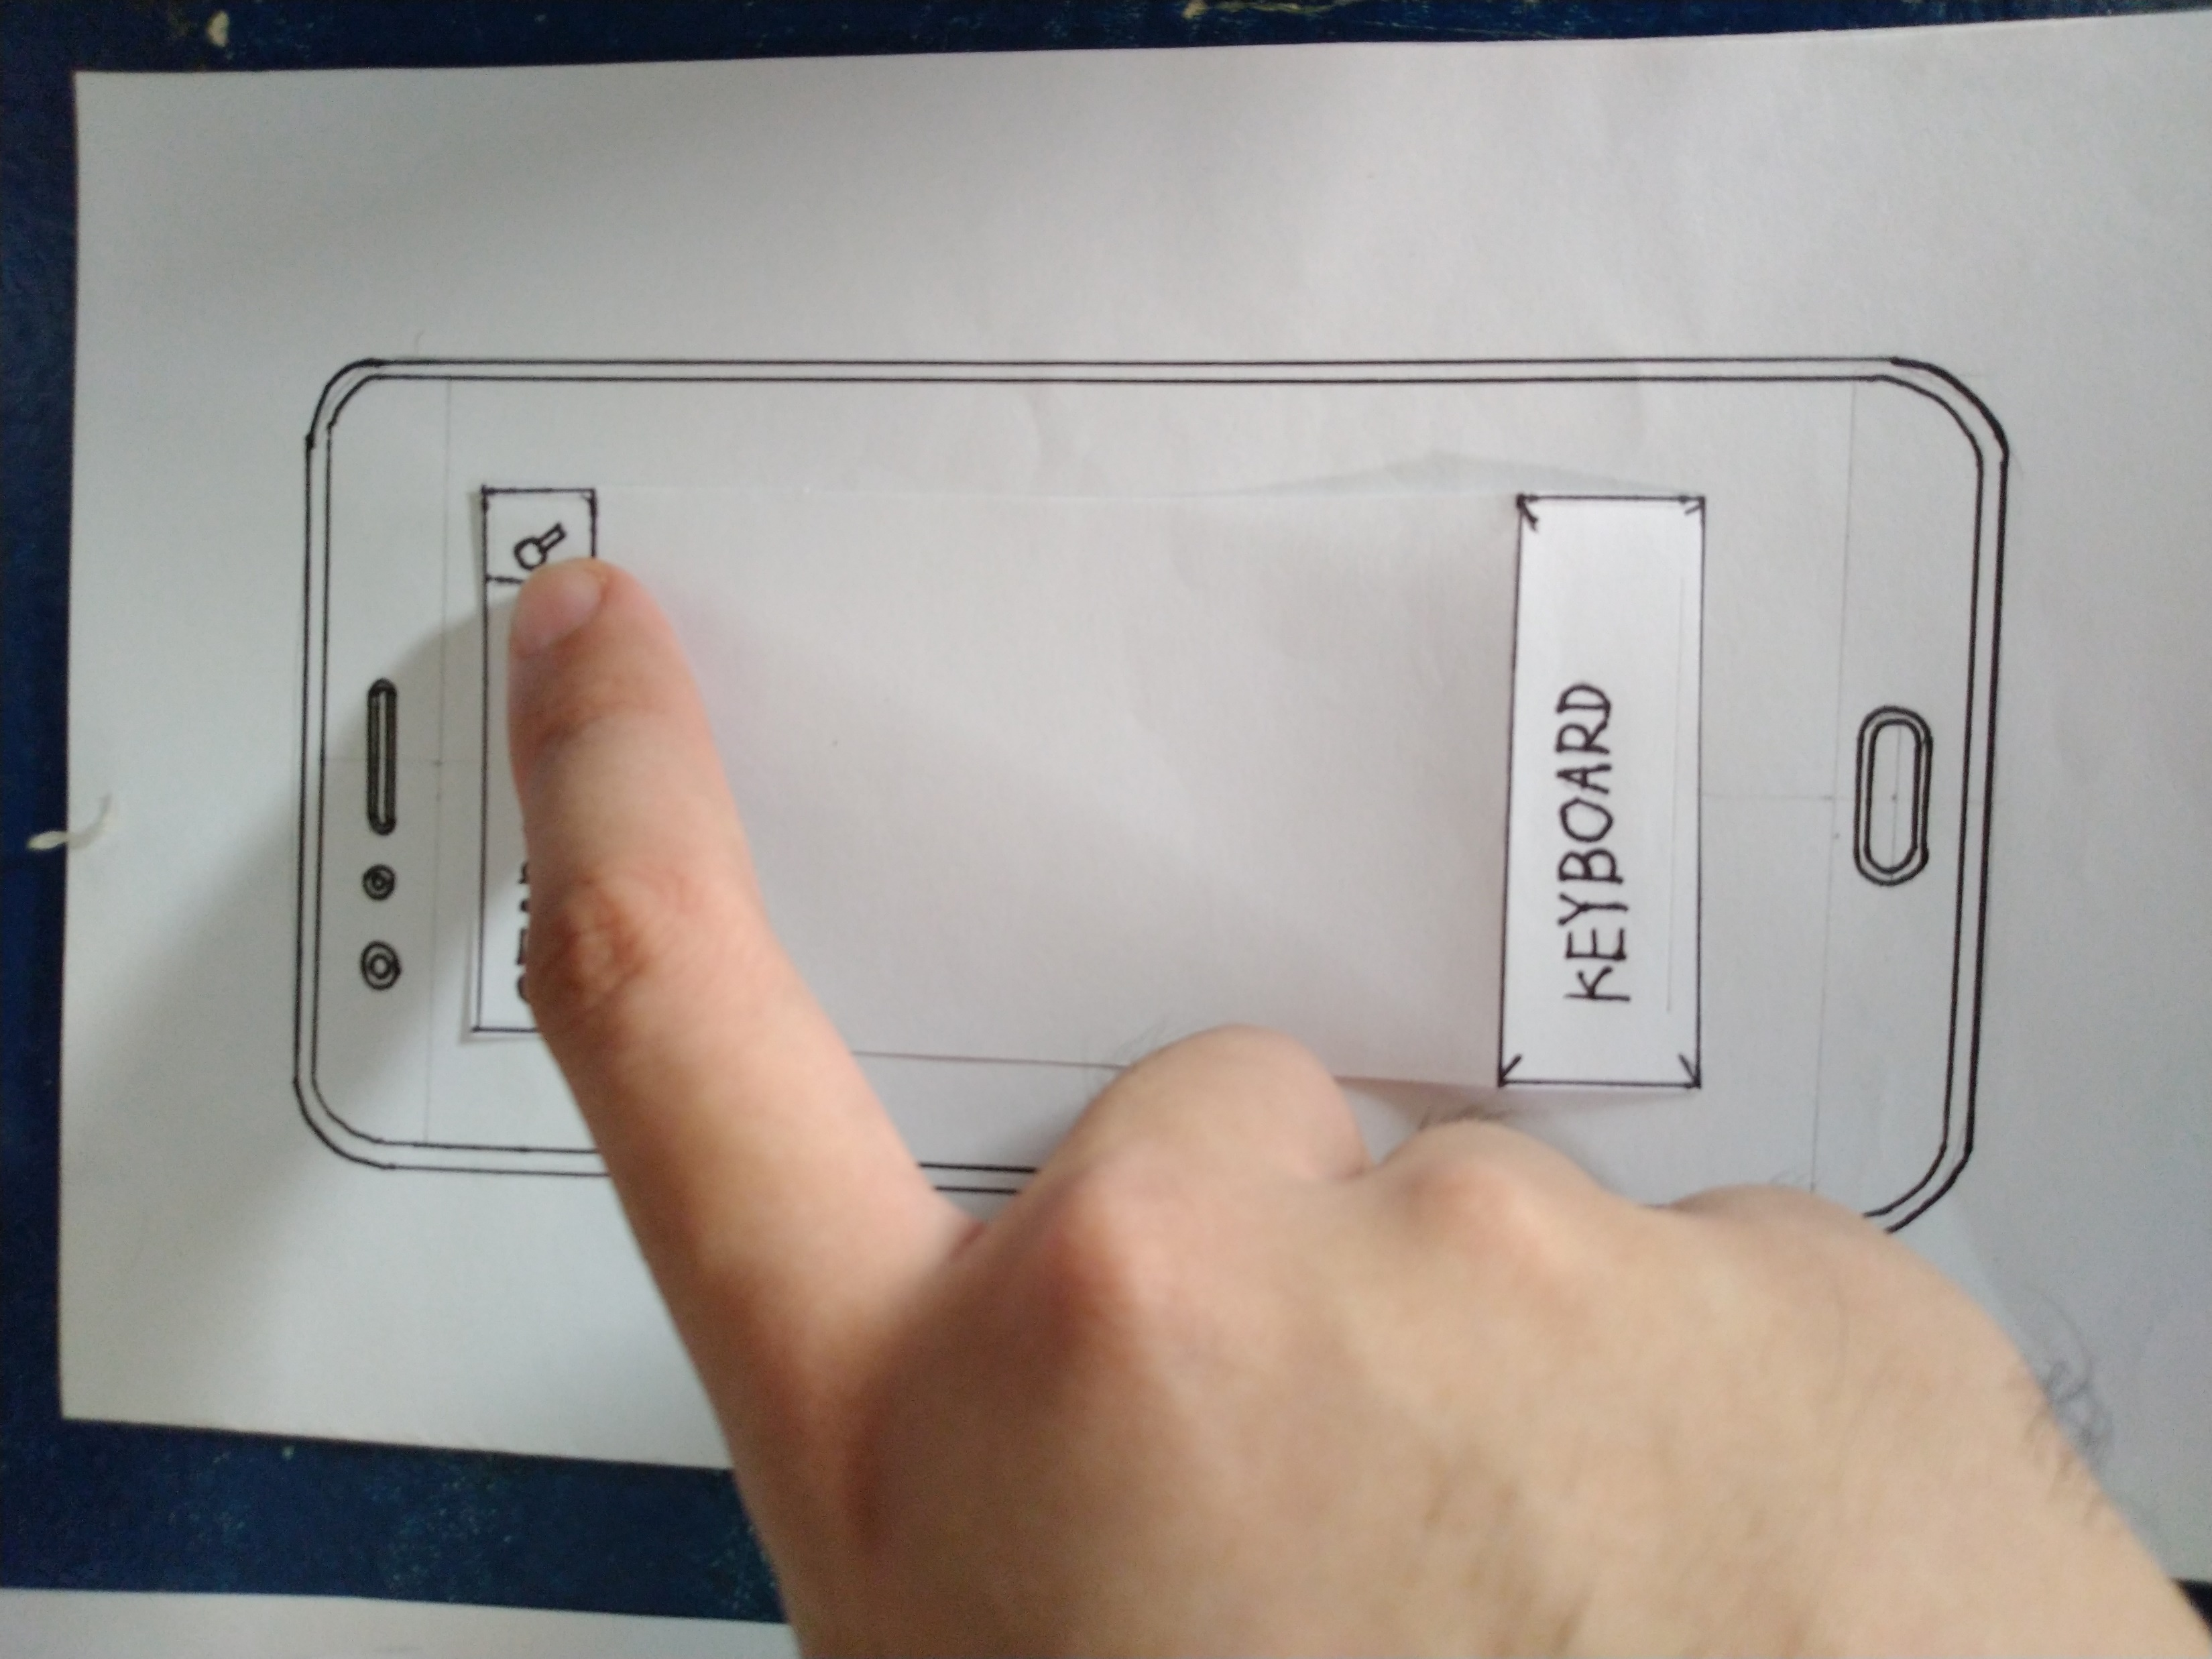
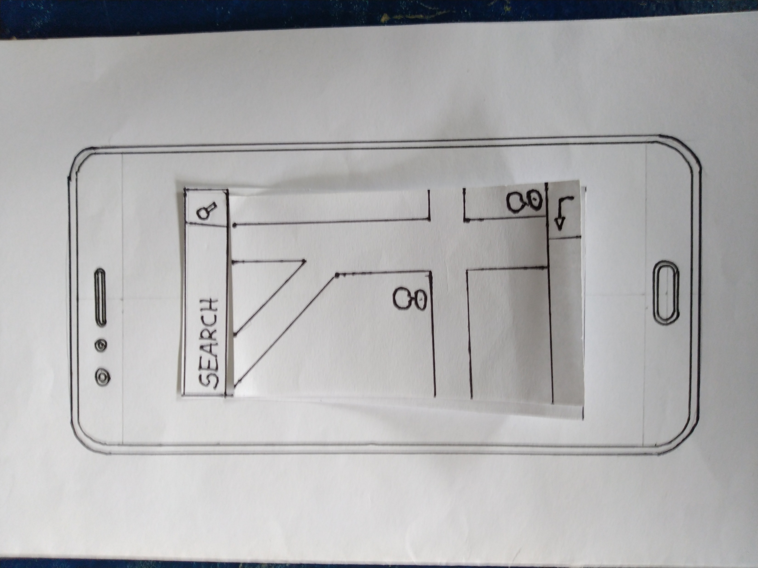
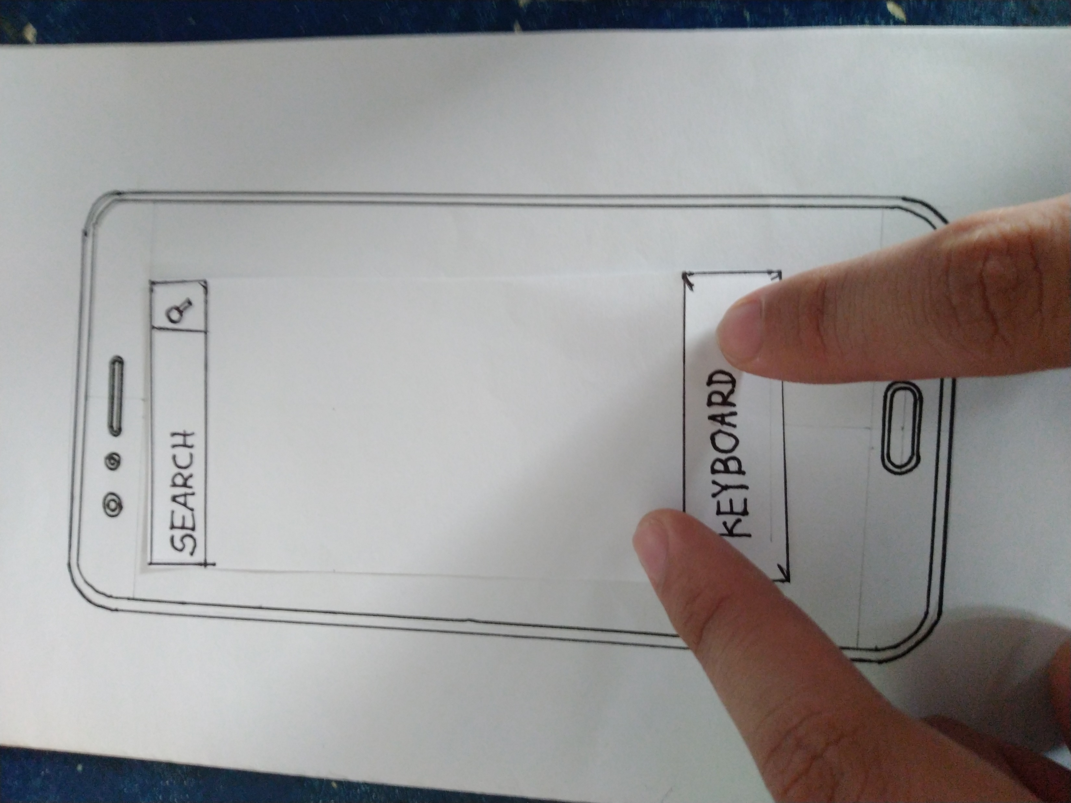
Paper Prototype 1

Slide 10

Thank You

